Slide 1
Exploring polygenic prediction in Africa
Tinashe Chikowore, PhD
Wellcome Trust International Training Fellow

Slide 2
Outline
From Africa to the World: My motivation
Polygenic risk scores exploration
Earlier perspectives
Diversity and polygenic prediction
Challenges of transferability in Africa
Polygenic risk score and network medicine
Mendelian Randomisation and Recall by genotype
Unravelling mechanistic insights of unique phenotypes
Application in the Nurses Health Study

Slide 3
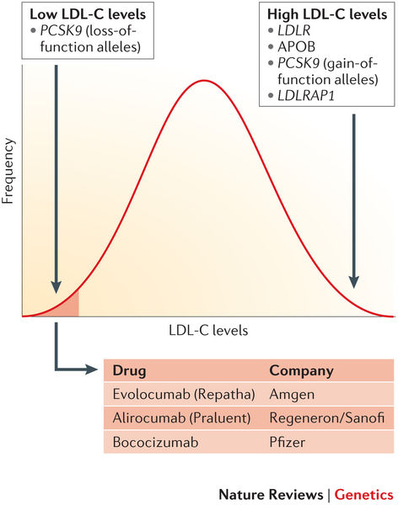
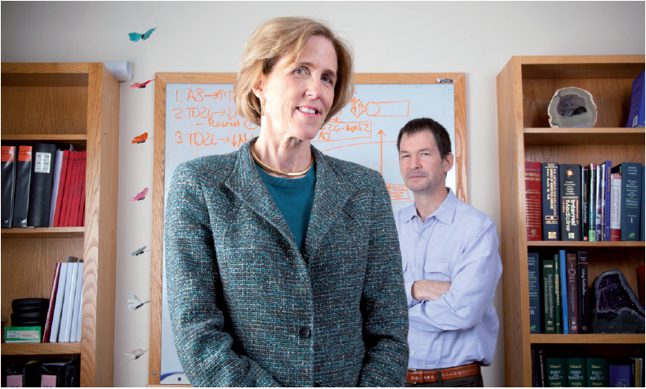

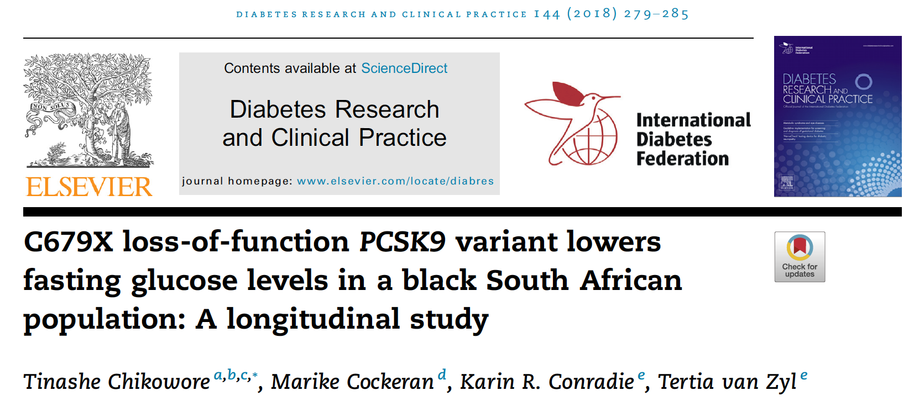
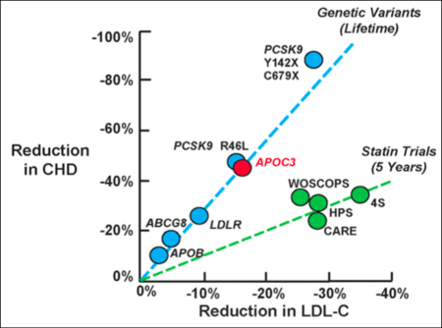
From Africa to the World: My Motivation
Hall, S.S. (2013). Nature 196:152-155

Slide 4
Polygenic risk scores basics
PRS_{j} = Σ [β_{i, discovery} * SNP_{ij}]
β_{i, discovery} = effect size in discovery sample from (continuous trait) or logistic reg (binary trait; β = log(OR))
SNP_{ij} = # alleles (0,1,2) for SNP i of person j in target sample

Slide 5
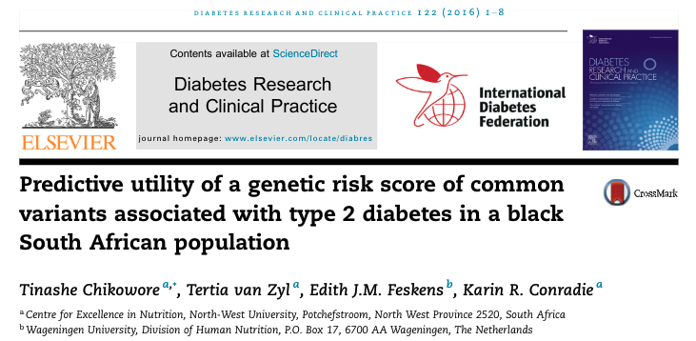
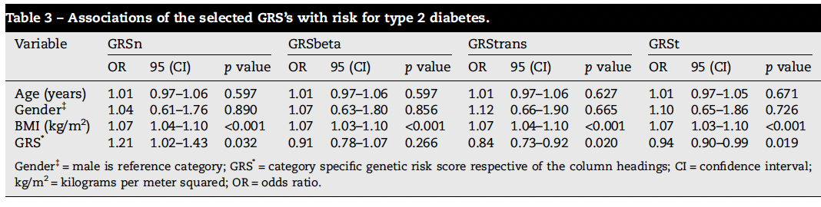
Polygenic risk scores…early exploration
Genetic risk with variants from Africa were more predictive
Captured uniqueness of diabetes in Africans
Stronger associations in younger (less than 50) and the lean
However, the scarcity of discovery studies was limiting this work

Slide 6
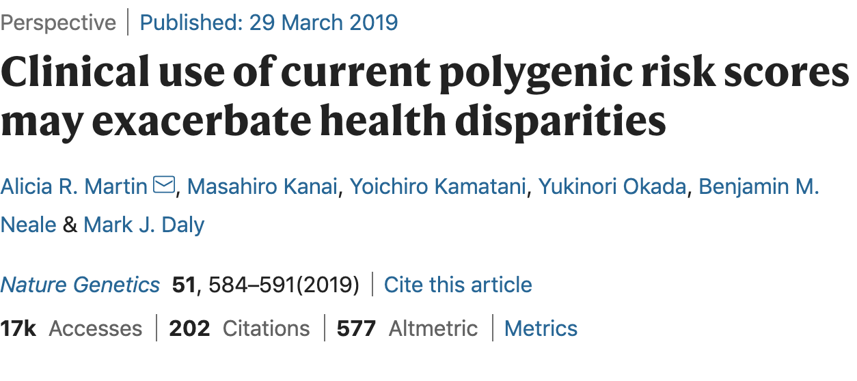
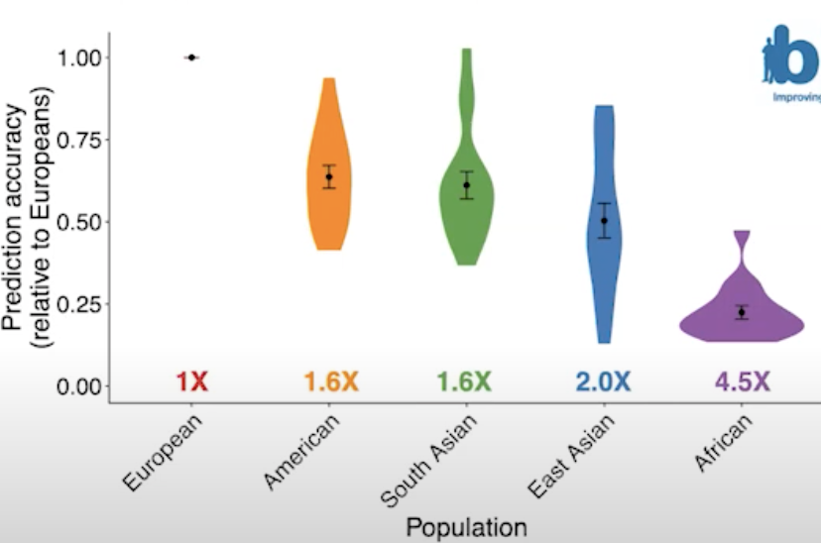
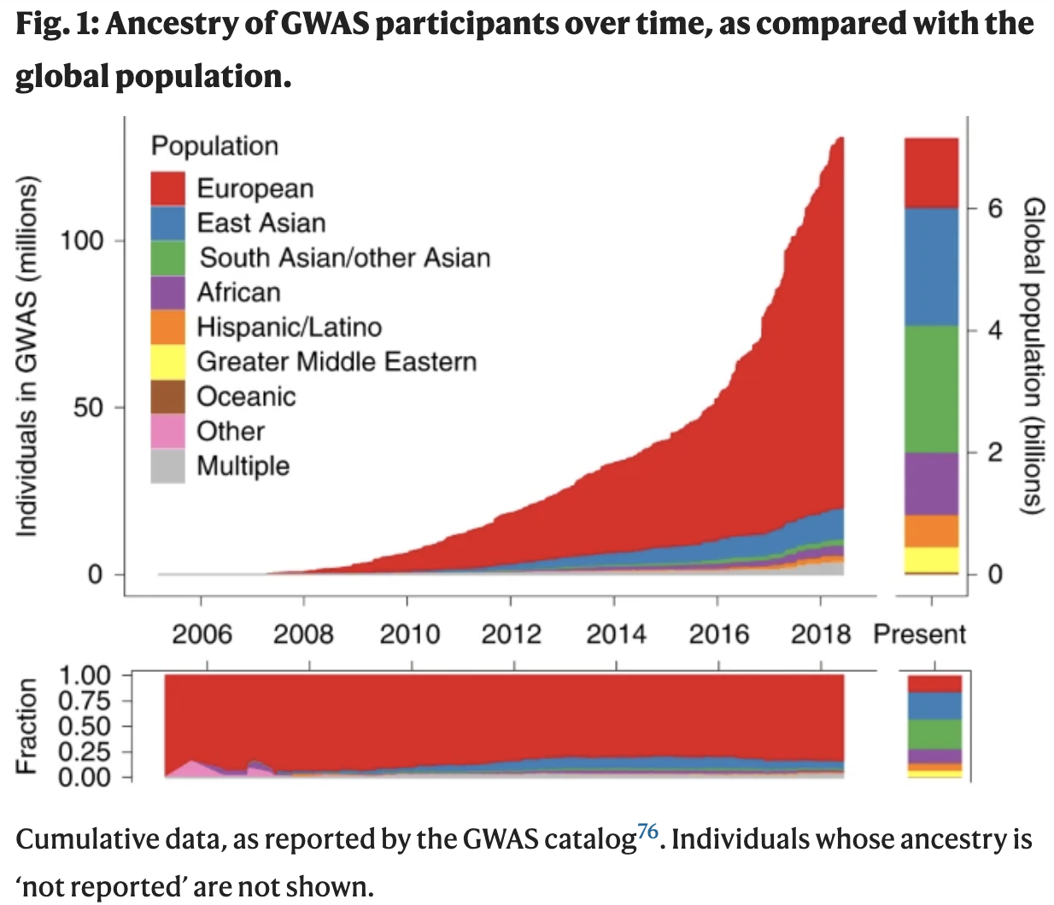
Diversity and polygenic risk scores
Differences in allele frequency , LD patterns

Slide 7
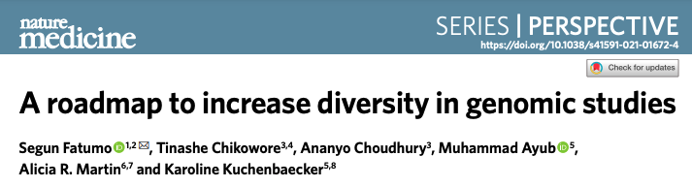
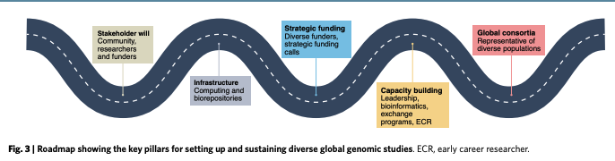
Promoting diversity: contributing to solutions

Slide 8
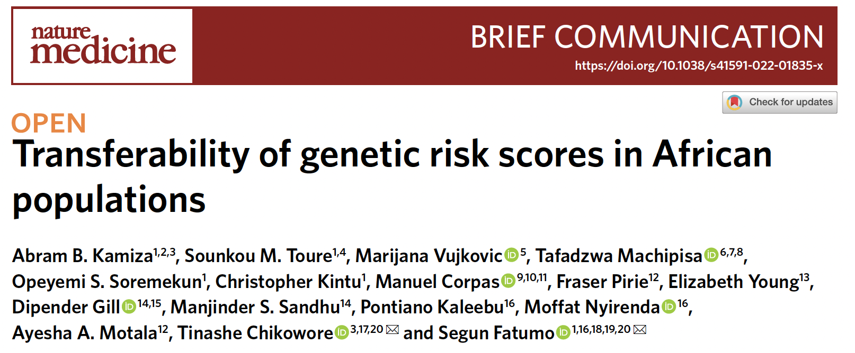
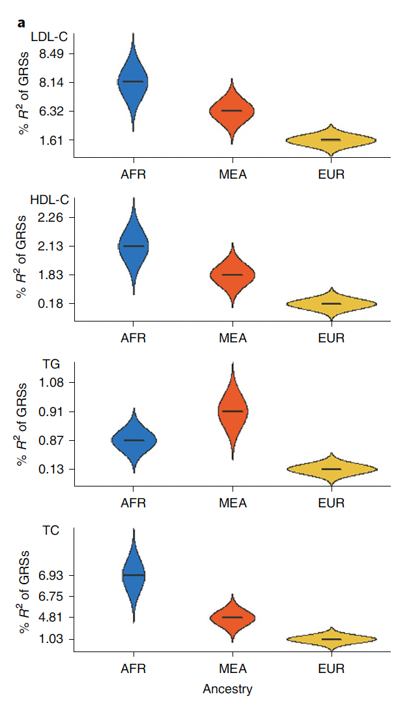
Usefulness of African American PRS in Africa
Discovery | African American | European | Multi- ancestry
Sample size | 57332 (19.3%) | 215551 (72.4%) | 297626

Slide 9
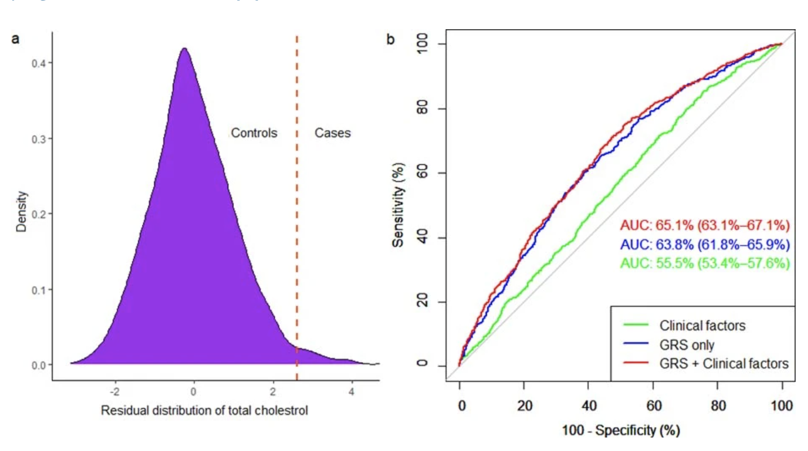
African American PRS better than conventional factors at identifying participants with elevated cholesterol levels
Case:- Top 10% and Controls: Bottom 90% of the PRS deciles
Clinical factors: age, sex and body mass index (BMI)
Kamiza et al. 2022 Nat Med 28:1163-1166

Slide 10
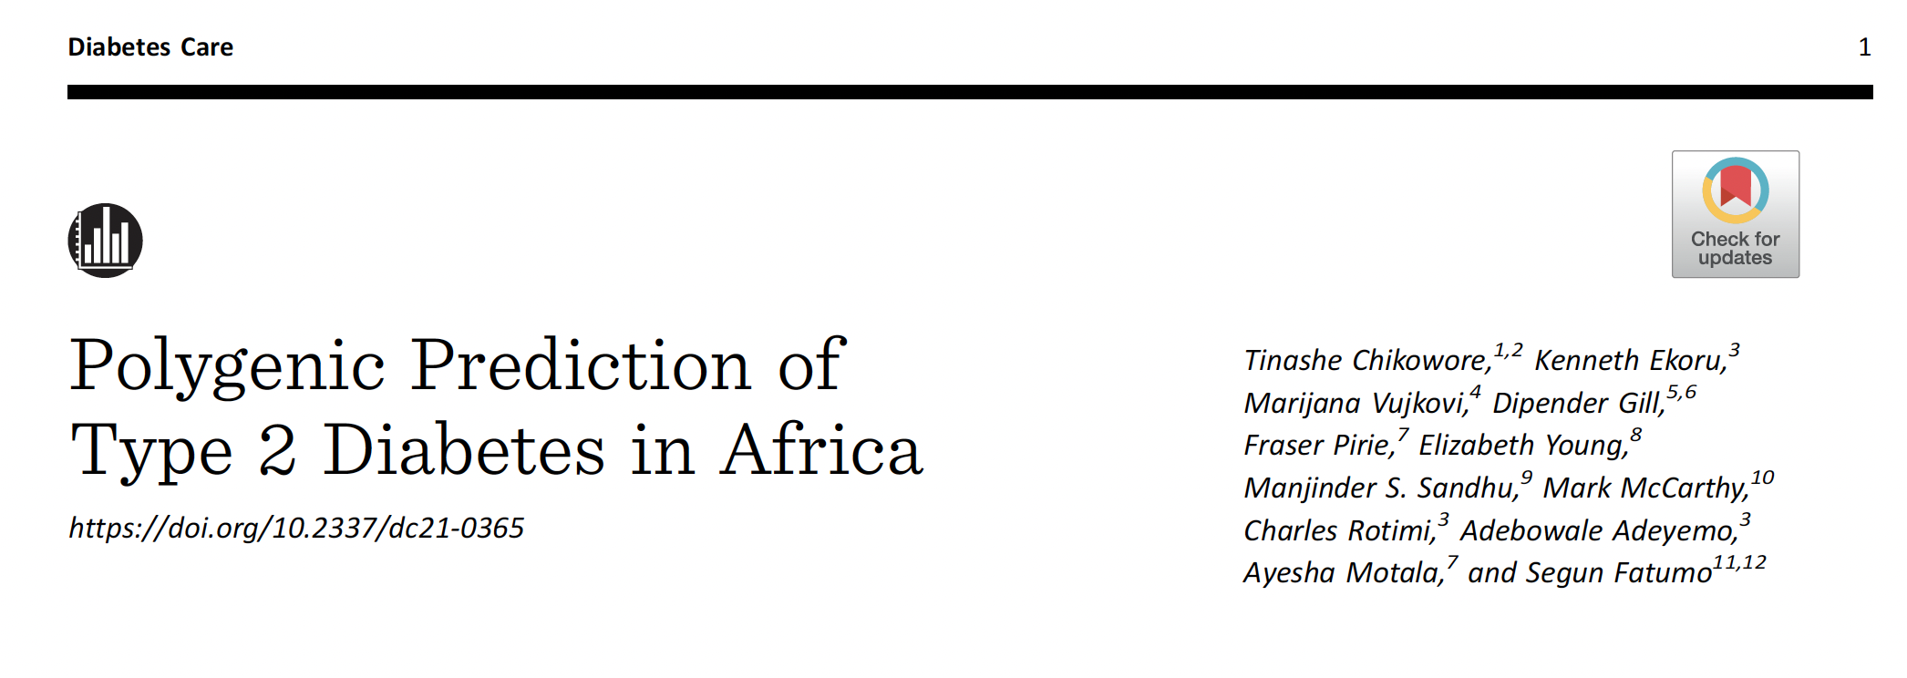
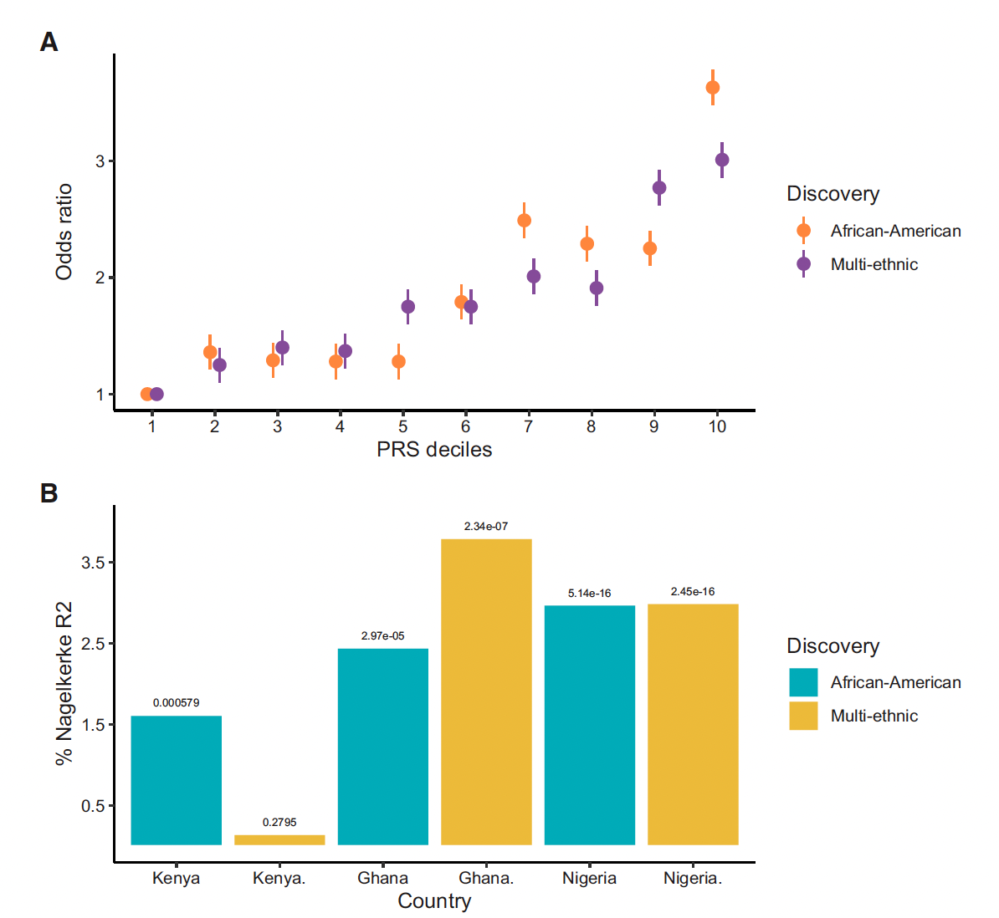
Making the most of what’s available
African American derived PRS more transferable than multi-ancestry.
There is regional variability in PRS prediction

Slide 11
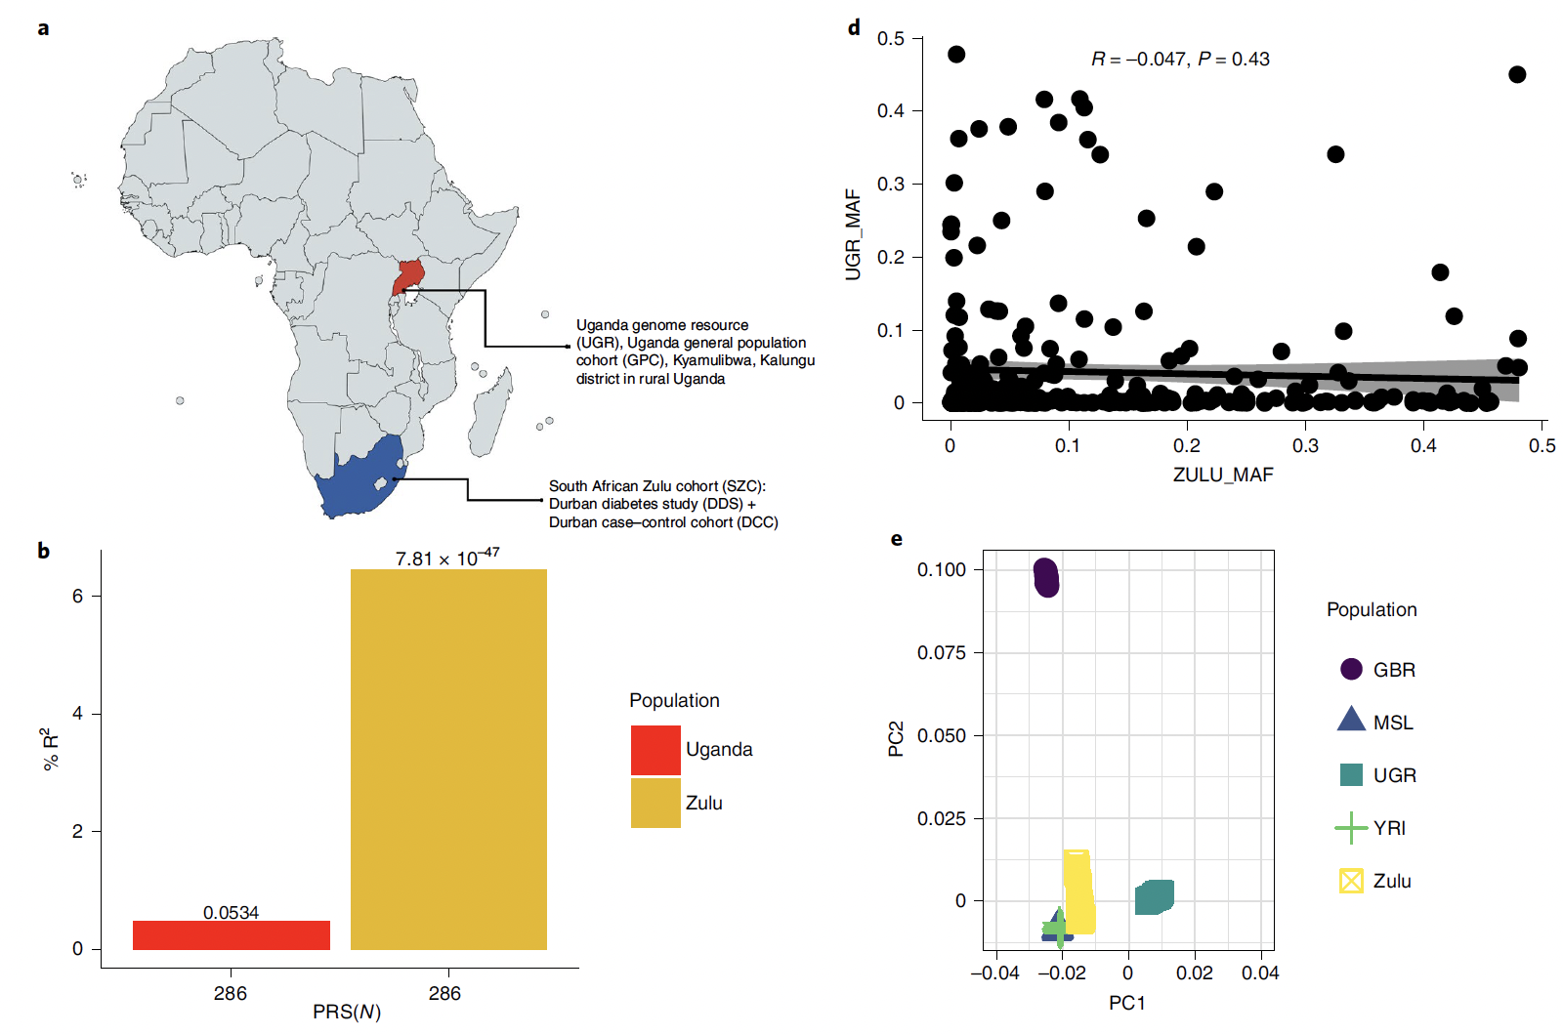
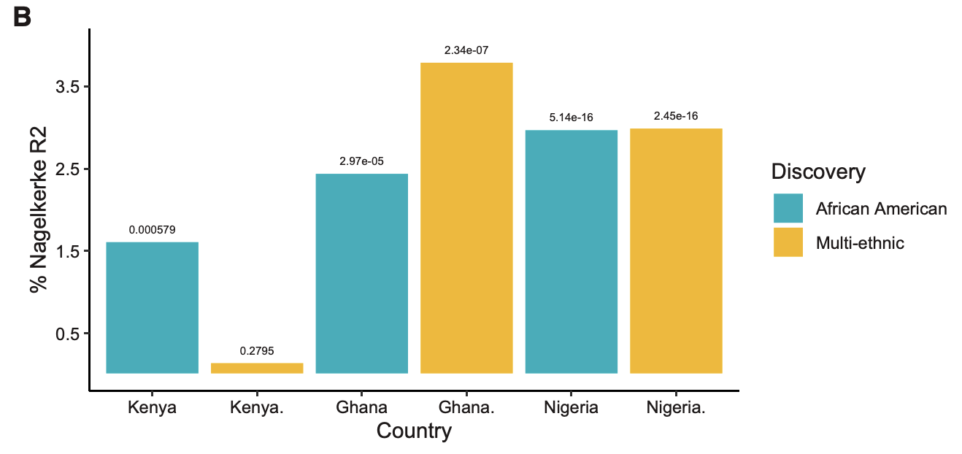
Could the African American PRS be biased to West Africa?
YRI = Yoruba from West Africa
Majority of African Americans originate from West Africa
Kamiza et al 2022 NatMed; Chikowore et al 2022, DiabCare

Slide 12
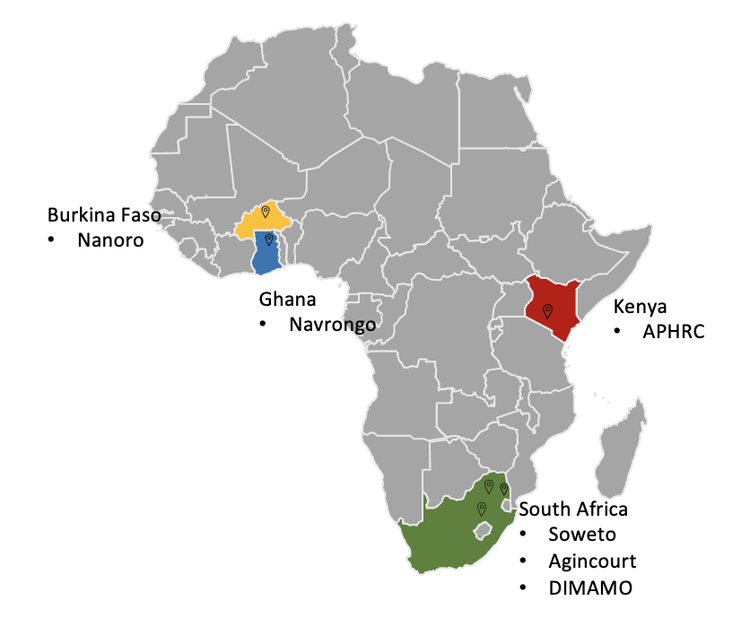
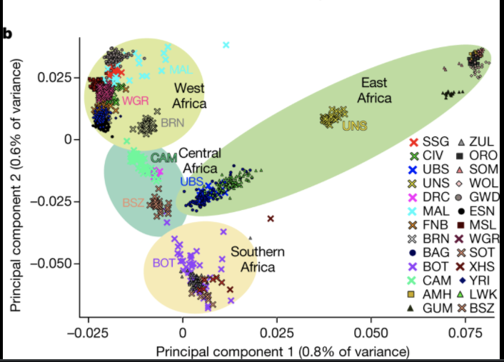
PRS and regional differences in Africa
Choudhury et al. Nat.Genet 2020

Slide 13
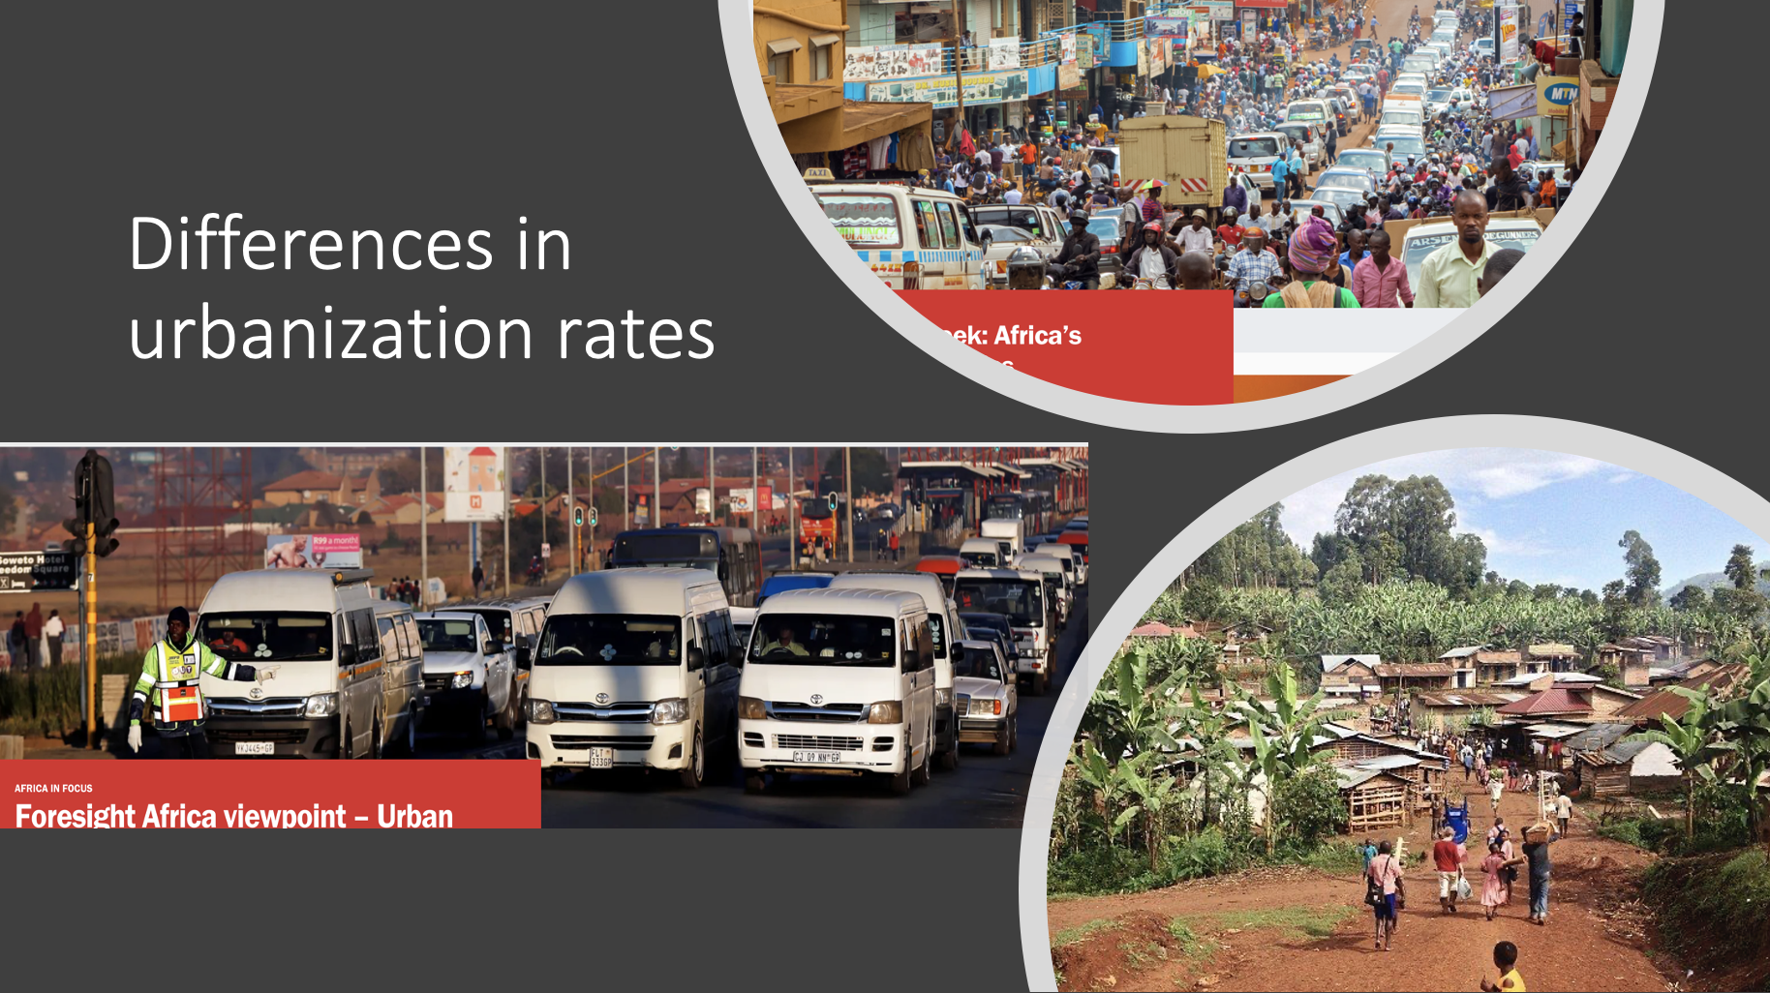
Africa a home for genetic and environmental diversity
3 million variants not found in current database
Choudhury et al. Nat 2020; 586, 741–748

Slide 14
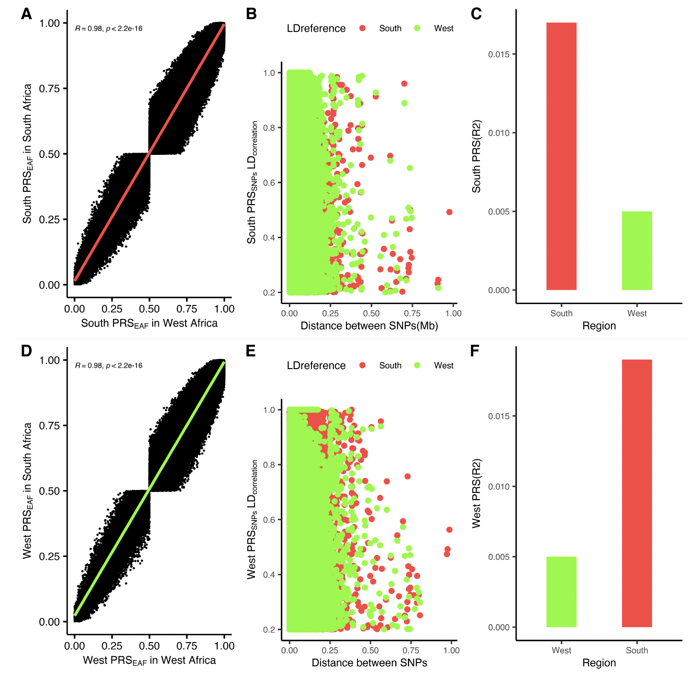
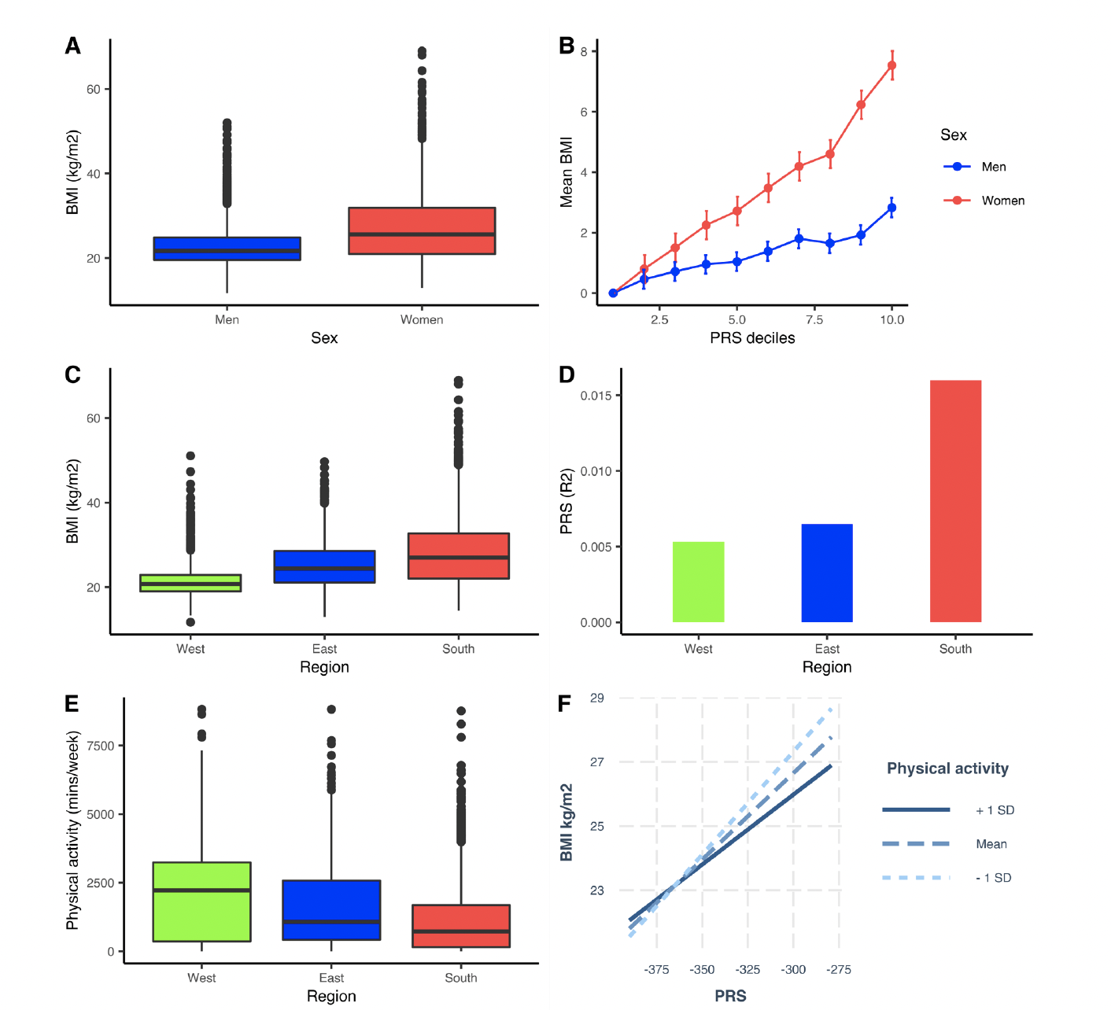
PRS-Environment interactions; Wellcome Trust Fellowship

Slide 15
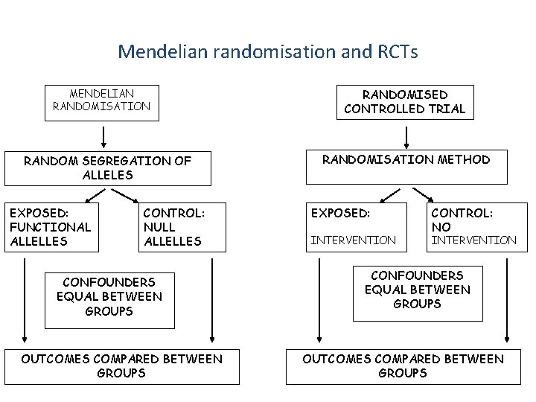
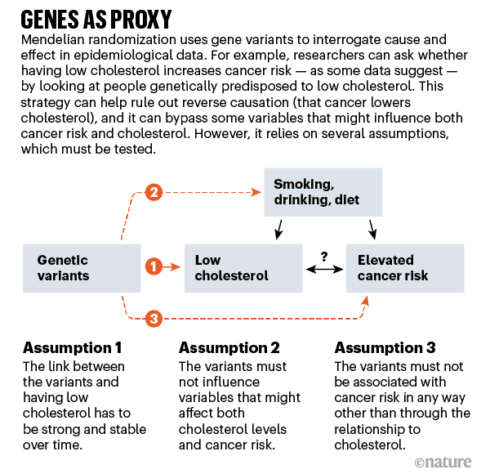
Mendelian Randomisation controls for confounding and reverse causation

Slide 16
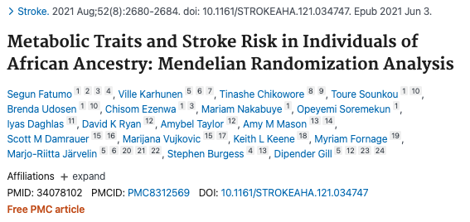
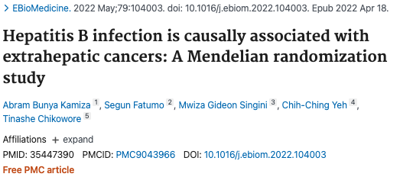
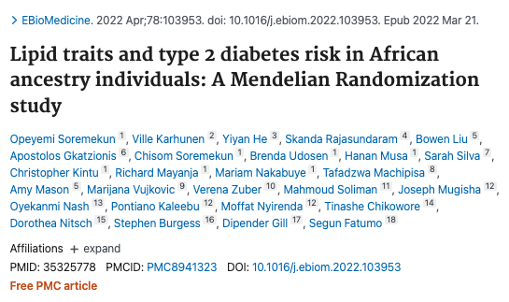
Causal inference work limited by diversity in GWAS

Slide 17
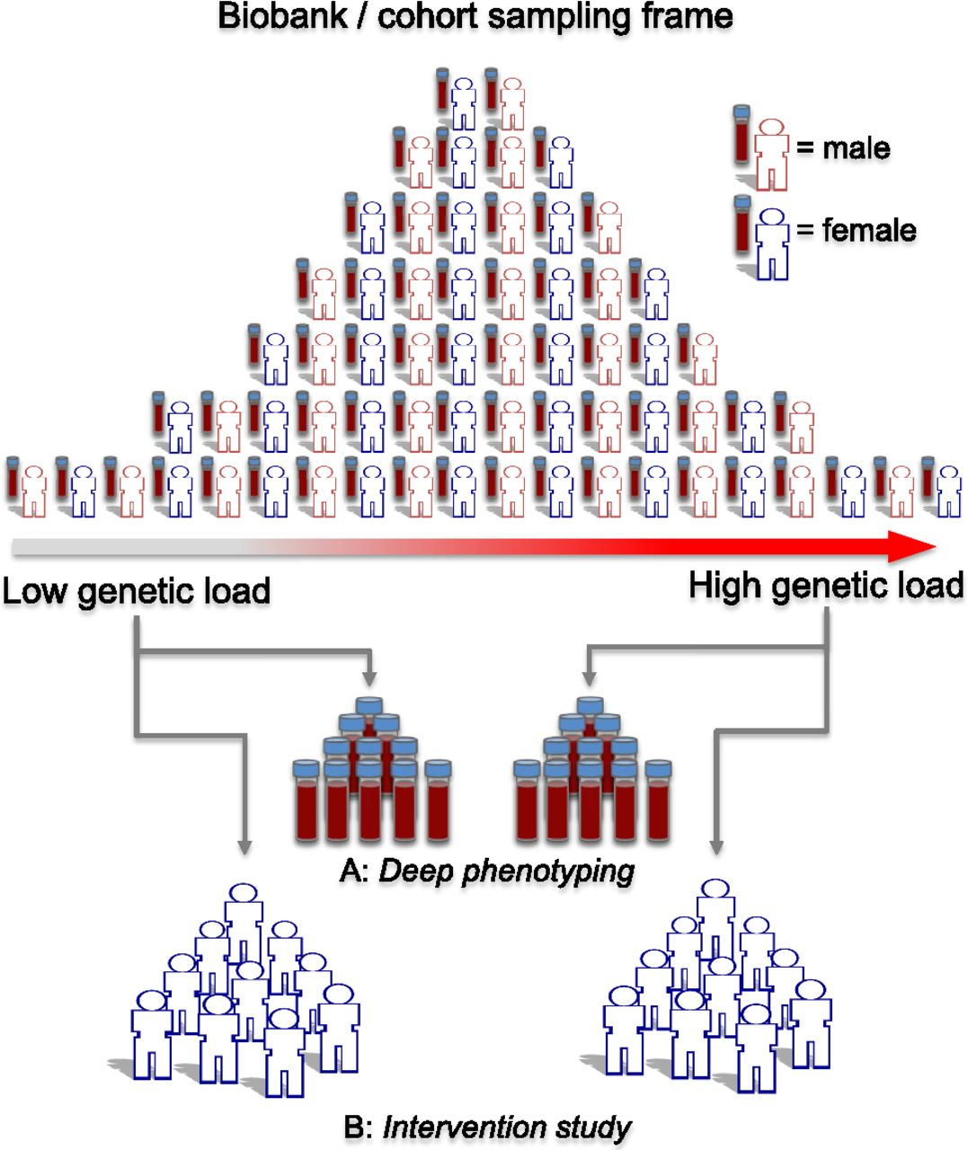
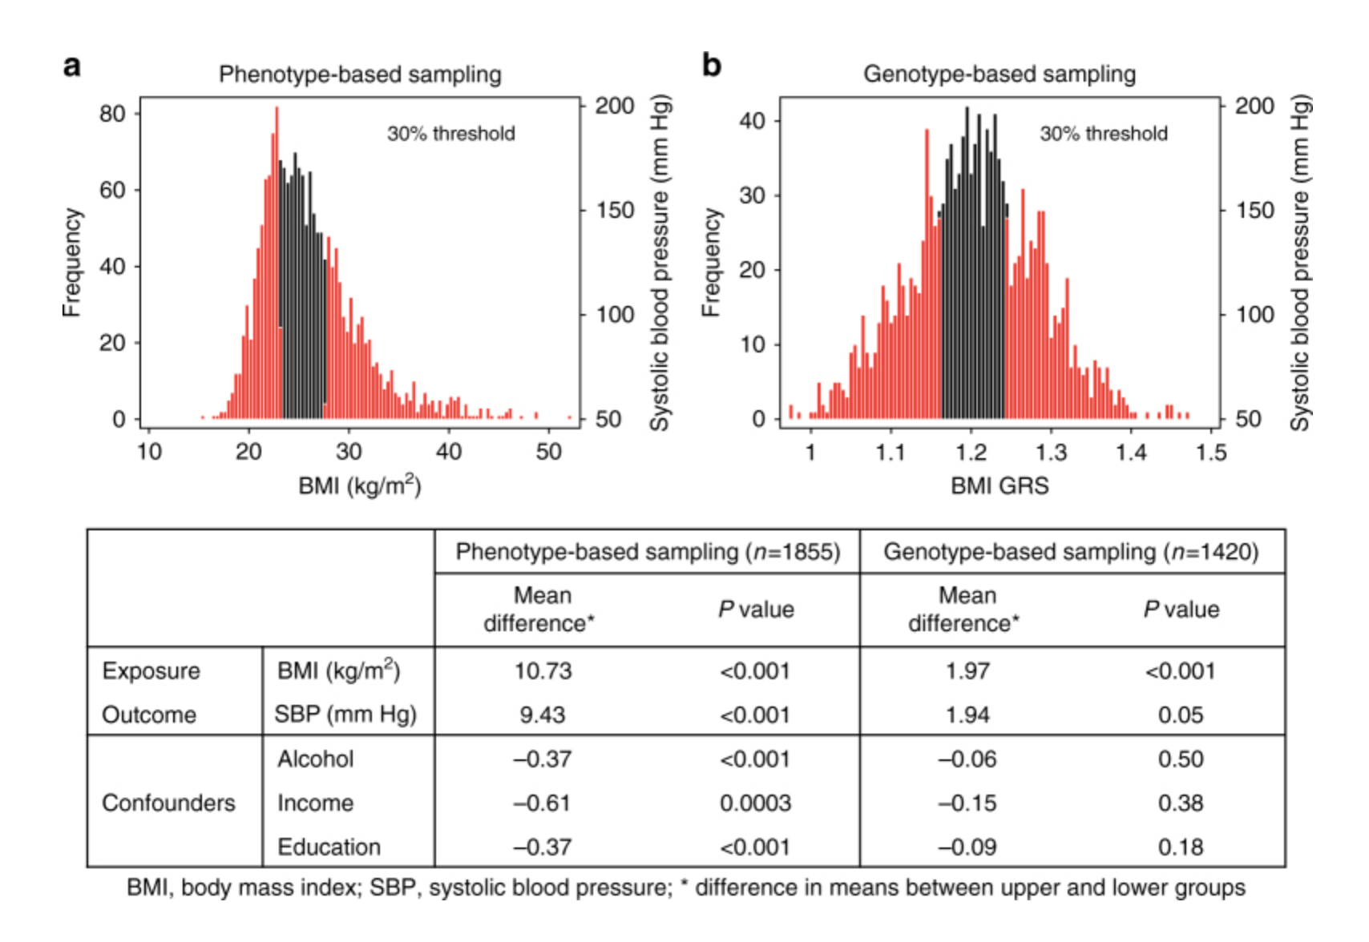
Recall by genotype study design controls for confounding and reverse causation
Fang, S.,et al. (2022). Obesity 30(6), 1298–1310.

Slide 18
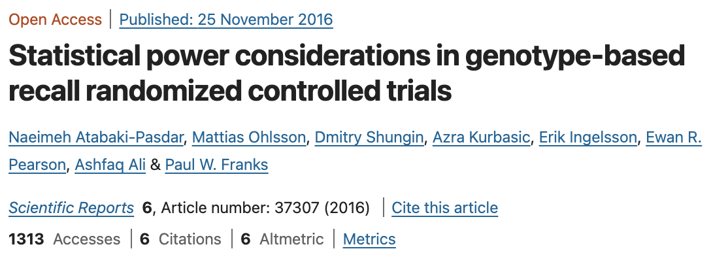
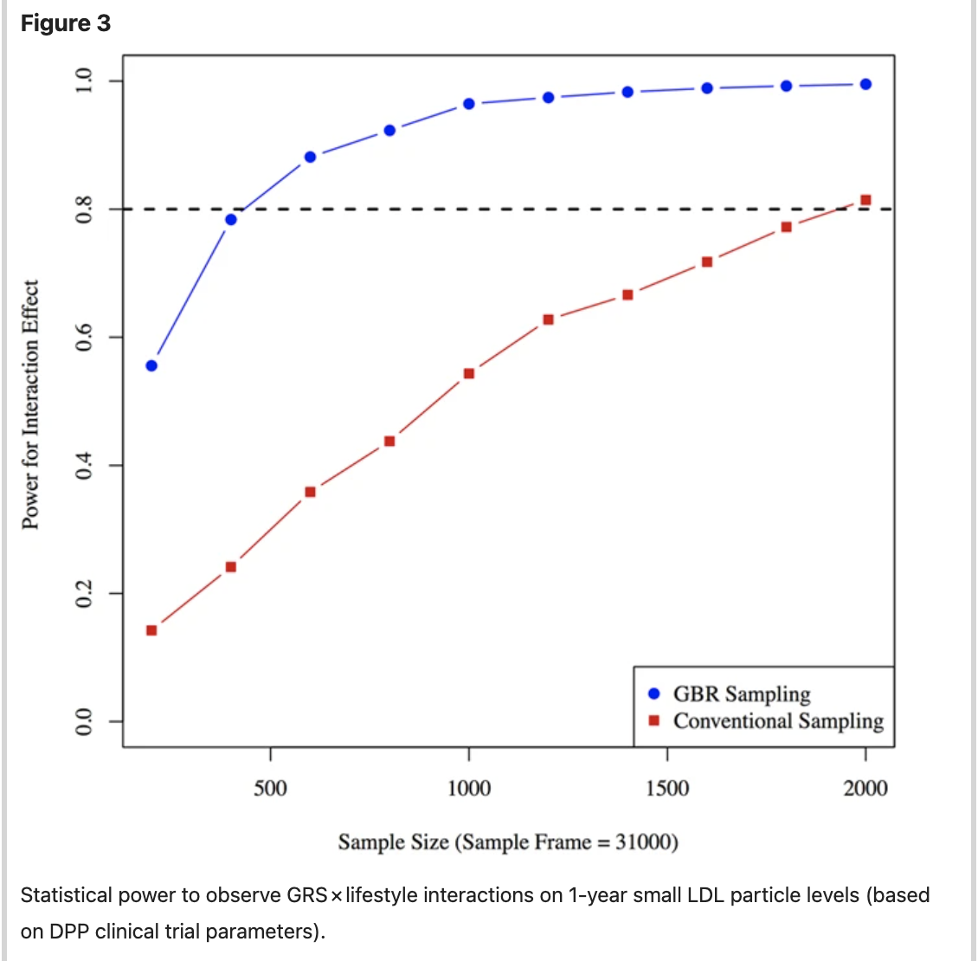
Recall by genotype designs and statistical power
To obtain 80% power , ~400 participants required using the GBR vs ~1,900 with conventional recruitment in RCT

Slide 19
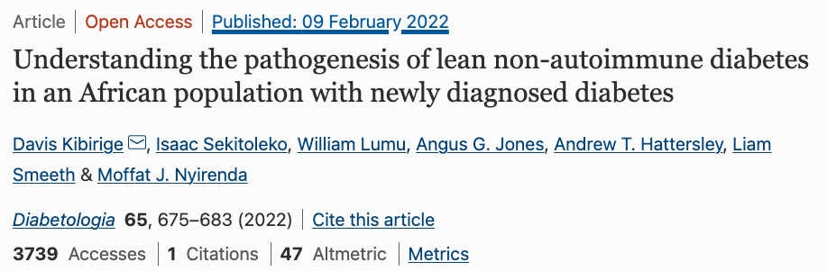
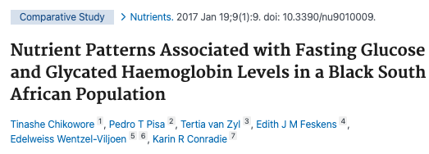
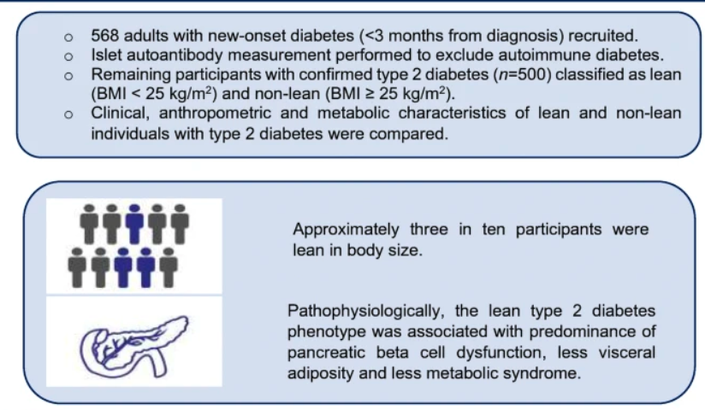
Implications for Network Medicine: Unravelling the mechanistic insights of lean diabetes in Africa
Diabetes is increasing rapidly in Africa but has a unique presentation
The management of diabetes using guidelines from developed countries where people are obese and diabetic might not be optimal in Africa

Slide 20
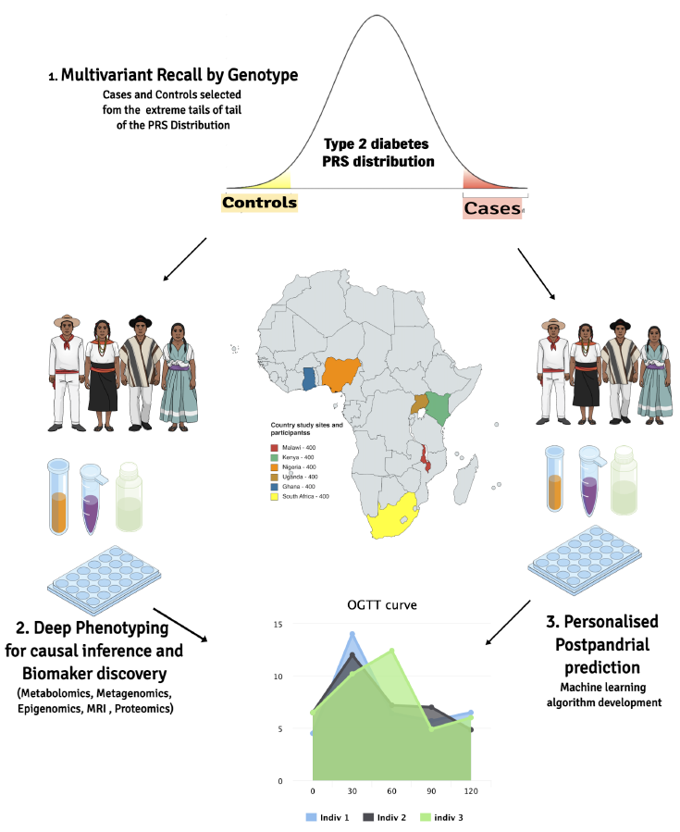
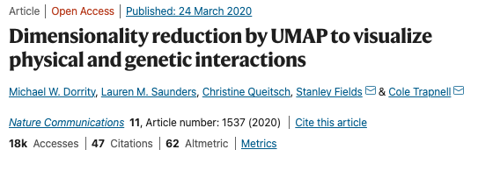
Study Design Leverage on network medicine and causal inference for recall by genotype study
Utilise machine learning approaches such as UMAP for Bayesian Network analysis and dimensionality reduction techniques such as DDRTree

Slide 21
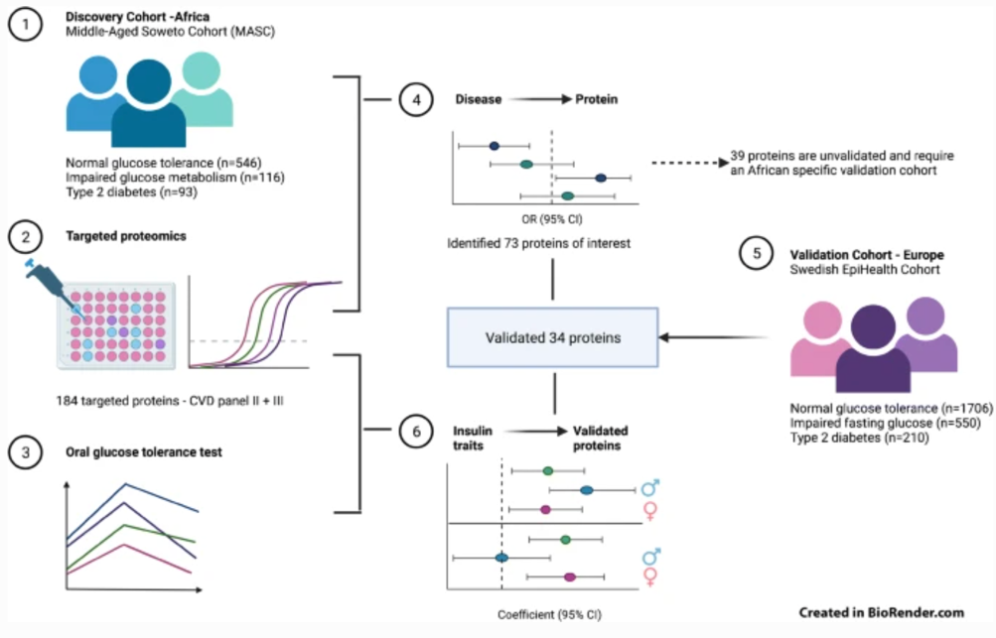
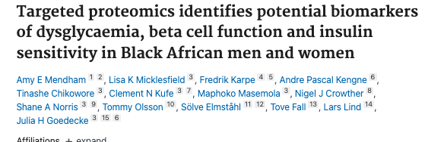
Evaluate transferability in the Nurses health study

Slide 22
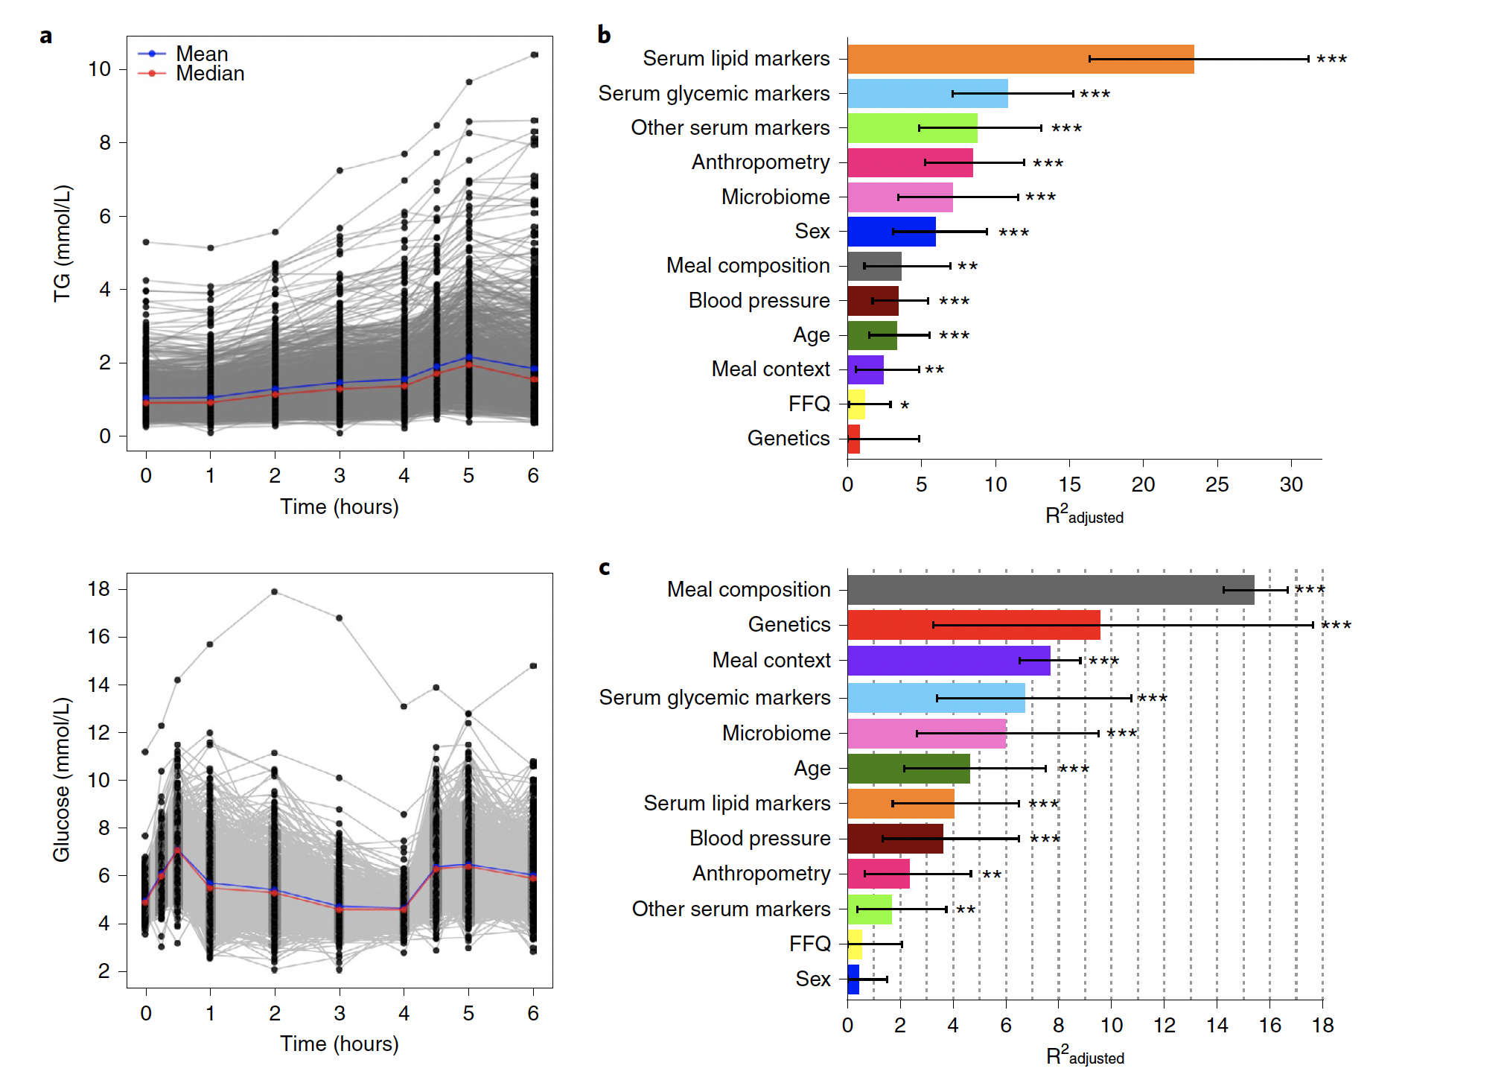
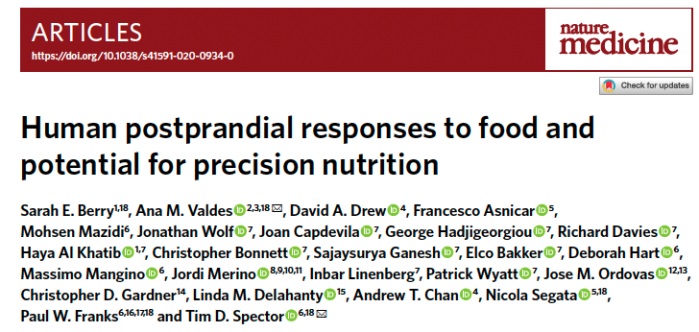
Longterm : Apply this in determining optimal personalised diets

Slide 23
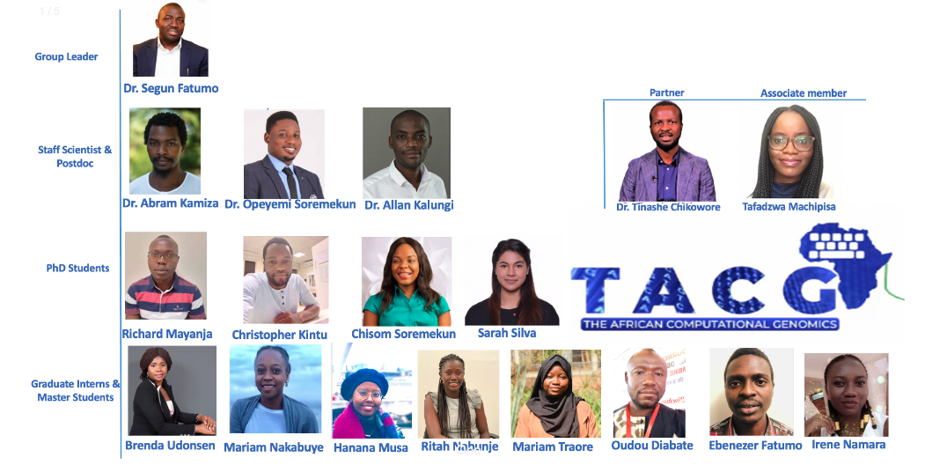
Acknowledgements

Slide 24






Sponsors and Supervisors
Prof M Ramsay, (Wits, SA)
Prof L Micklesfield, (Wits, SA)
Prof PW Franks (Lund, Sweden)
Prof AP Morris (UM, UK)
Prof G Pare (McMaster, Canada)
Collaborators
Prof S Fatumo (LSHTM, MRC)
Prof Z Lombard (Wits, SA)
Prof G Goedecke (SAMRC, SA)

